Slide 1
Policy Update
Ann Rodriguez

Slide 2
Do You Consider Yourself an Advocate?
Life Experience=
Invaluable Expertise and Perspective=
Notes:
Ann and Stacy

Slide 3
What is a Policy?
The federal Centers for Disease Control gives this definition of policy:
Policy is a law, regulation, procedure, administrative action, incentive, or voluntary practice of governments and other institutions. Policy decisions are frequently reflected in resource allocations. Health can be influenced by policies in many different sectors.
That means that a policy can be determined by:
A law passed by the US Congress or the NC General Assembly.
A rule or policy (these are regulations) put in place by the NC Department of Health and Human Services or the Department of Public Instruction or other state agencies.
A ruling by a court.
A practice that the federal or state government allows.
An ordinance passed by the county commissioners or city councils.
Notes:
Ann

Slide 4
Who are Policy Makers You Can Advocate To?
NC DHHS Secretary Kody Kinsley
Members of US Congress
Members of NC General Assembly
State Agency representatives
County Commissioners
County and Local Officials of governments, school systems, etc.
NC General Assembly House Speaker Tim Moore
NC President Pro Tempore of the Senate Phil Berger
Notes:
Stacy

Slide 5
Why Now?
Registry of Unmet Needs
Samantha R. Ruling
Medicaid Transformation
Integrated Care
Care Management
1915i Services
Workforce Shortage
Major Changes to the Structure of the Public Service System for Individuals with Intellectual –Developmental Disabilities are Underway!
This is an OPPORTUNITY to ADVOCATE!
Notes:
Stacy

Slide 6
The Registry of Unmet Needs (RUN)
The Registry of Unmet Needs or RUN in North Carolina is a Registry, or wait list, for individuals who are eligible for the NC Medicaid Innovations Waiver but there are no slots available.
Currently, there are approximately 15,000 people on the RUN in North Carolina.
People on waitlists for Medicaid Waivers in other states in the U.S. have an average wait time of over two years. In North Carolina, the wait can be up to 12 years or more.

Slide 7
Samantha R. Ruling
On November 2, 2022, the Court in Samantha R. issued an Order requiring the state to meet benchmarks toward serving people with I/DD. The state has appealed and asked to delay these requirements. A hearing on the appeal is set for February 3, 2023. The appeal itself will take at least a year. (for more information go to DRNC webpage)
The benchmarks include: eliminating the Innovations Waiver waiting list over the next 10 years; serving those who want to move to community settings (or to avoid institutionalization) over the next 8 years; and addressing the Direct Support Provider (DSP) shortage.
NC DHHS has developed a plan of action that includes: increase wages for Direct Support Professionals; increase Innovations Waiver slots; strengthen LME/MCO accountability for providing authorized waiver services; encourage and support large private facilities with over 50 beds to convert to smaller settings; continue to shorten the length of stays in state-operated I/DD facilities; create in-reach plan for people with I/DD in Adult Care Homes.

Slide 8
Medicaid Transformation—BH/IDD Tailored Plans Begin on April 1:
Integrated Care
Care Management
1915i Services
BH/IDD (write out BH) Tailored Plans will be responsible for I/DD services AND mental health, substance use and physical health services AND medications AND non-medical drivers of health like transportation, food security, housing and interpersonal safety
Every person who is a member of a BH/IDD Tailored Plan will choose or be assigned a care manager. This will be a different service than what you have had under the LME/MCOs. There will be more frequent contact with you based on your level of need. There was a “soft start” allowing for transition time on December 1, 2022
1915i services is a new structure that replaces the (b)(3) services. A big difference is that anyone on Medicaid may be eligible for 1915i services 1915i is expected to include services that include responsibilities you are familiar with: supported employment, community transition, respite, community living and supports. NC is in discussion with the federal government for final approval.
Notes:
Ann

Slide 9
Medicaid Transformation—Identify Your Call to Action—Translating these Changes
Integrated Care
Care Management
1915i Services
What are your priorities in integrated care?
How could integrated care improve and strengthen your services and supports?
What do you need from a care manager to have a strong relationship?
How can your families and natural supports be involved and assist with success?
What do you need most while you wait for an Innovations Waiver slot?
What do you need to be a part of your week to help you feel a part of your community and to feel you have had a meaningful day?
Notes:
Ann

Slide 10
Delete this slide – we can provide these resources as followup or on web site Expect Glitches and Identify System Issues that Need Rework
NC DHHS Medicaid Transformation Email for Feedback: Medicaid.Transformation@dhhs.nc.gov
NC Enrollment Broker: ncmedicaidplans.gov
Phone: 1-833-870-5500 (TTY: 711 or RelayNC.com)
Hours of operation: 7 a.m. to 8 p.m., Monday through Friday and 7 a.m. to 5 p.m. on Saturday
Chat Tool at website
NC Medicaid Ombudsman: https://ncmedicaidombudsman.org/
Phone: 877-201-3750
Live agents: 8 a.m. to 5 p.m. Monday through Friday, except State holidays.
Notes:
Ann

Slide 11
Workforce Shortage
The pandemic has shone a bright light on the workforce shortage.
There was already a shortage of Direct Support Professionals (DSP).
NC General Assembly did provide some short-term funding to address the DSP shortage.
We have indications that funding to increase pay rates will be included in the Governor’s budget recommendations and that the General Assembly will be considering this during the session they are in right now
Notes:
Stacy

Slide 12
Resources for You as an ADVOCATE:
end ofUse QR Code on Meet the Need NC flyer to get on the mailing list! - delete- we will tell them at the the meeting where to go -s delete next slide with infographic
NC General Assembly Website
NC Council on Developmental Disabilities
NC Department of Health and Human Services
NC Department of Public Instruction
Exceptional Children’s Assistance Center
Associations and Organizations:
The Arc of NC
Autism Society of NC
i2i center for Integrative Health
MHTA/LAND (facebook)
Notes:
Stacy

Slide 13
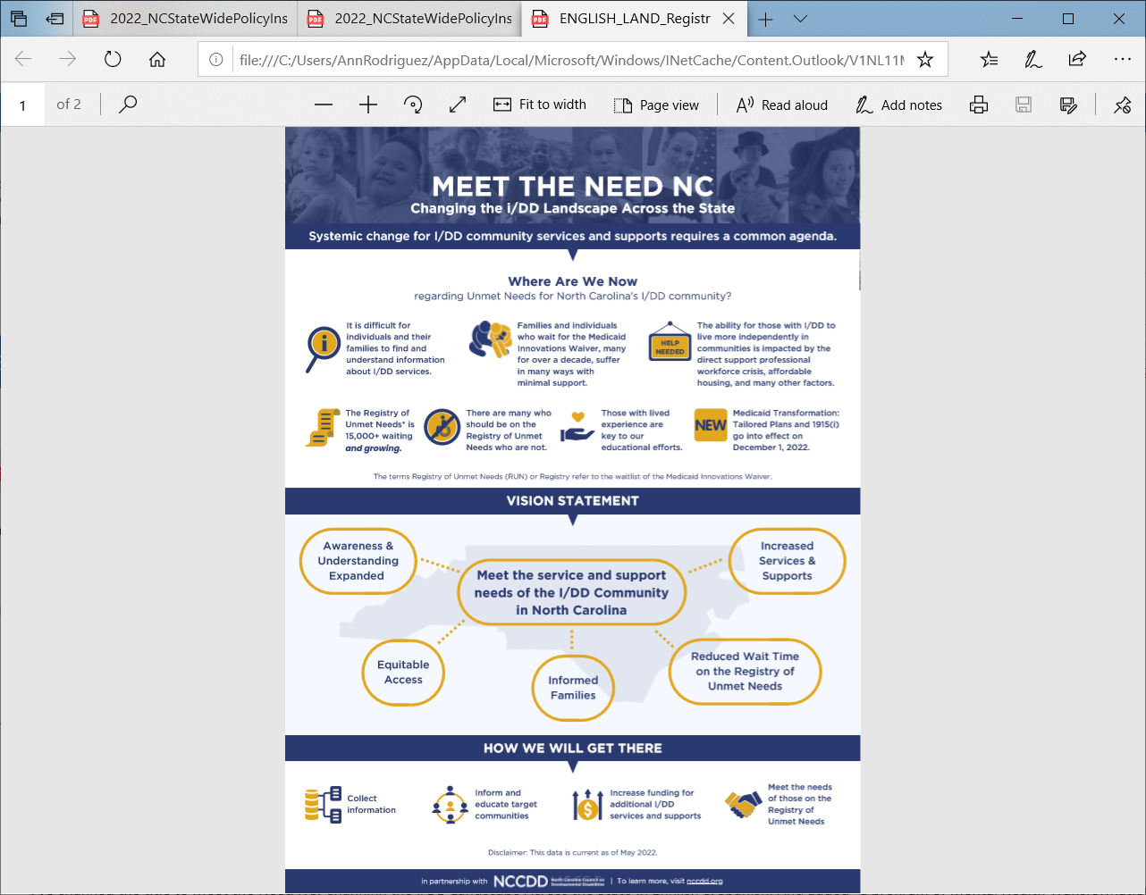
Notes:
Ann

Slide 14
To reach me:
Ann Rodriguez
Executive Director, i2i Center for Integrative Health
ann@i2icenter.org
919-744-7937

